Slide 1
Opinionated Product Development
In A Newsroom

Slide 2

Storyful and me
4.5 years, from 5 to 80 people, Ukraine to Dublin, constant chaos to 2 weeks of chaos at a time

Slide 3
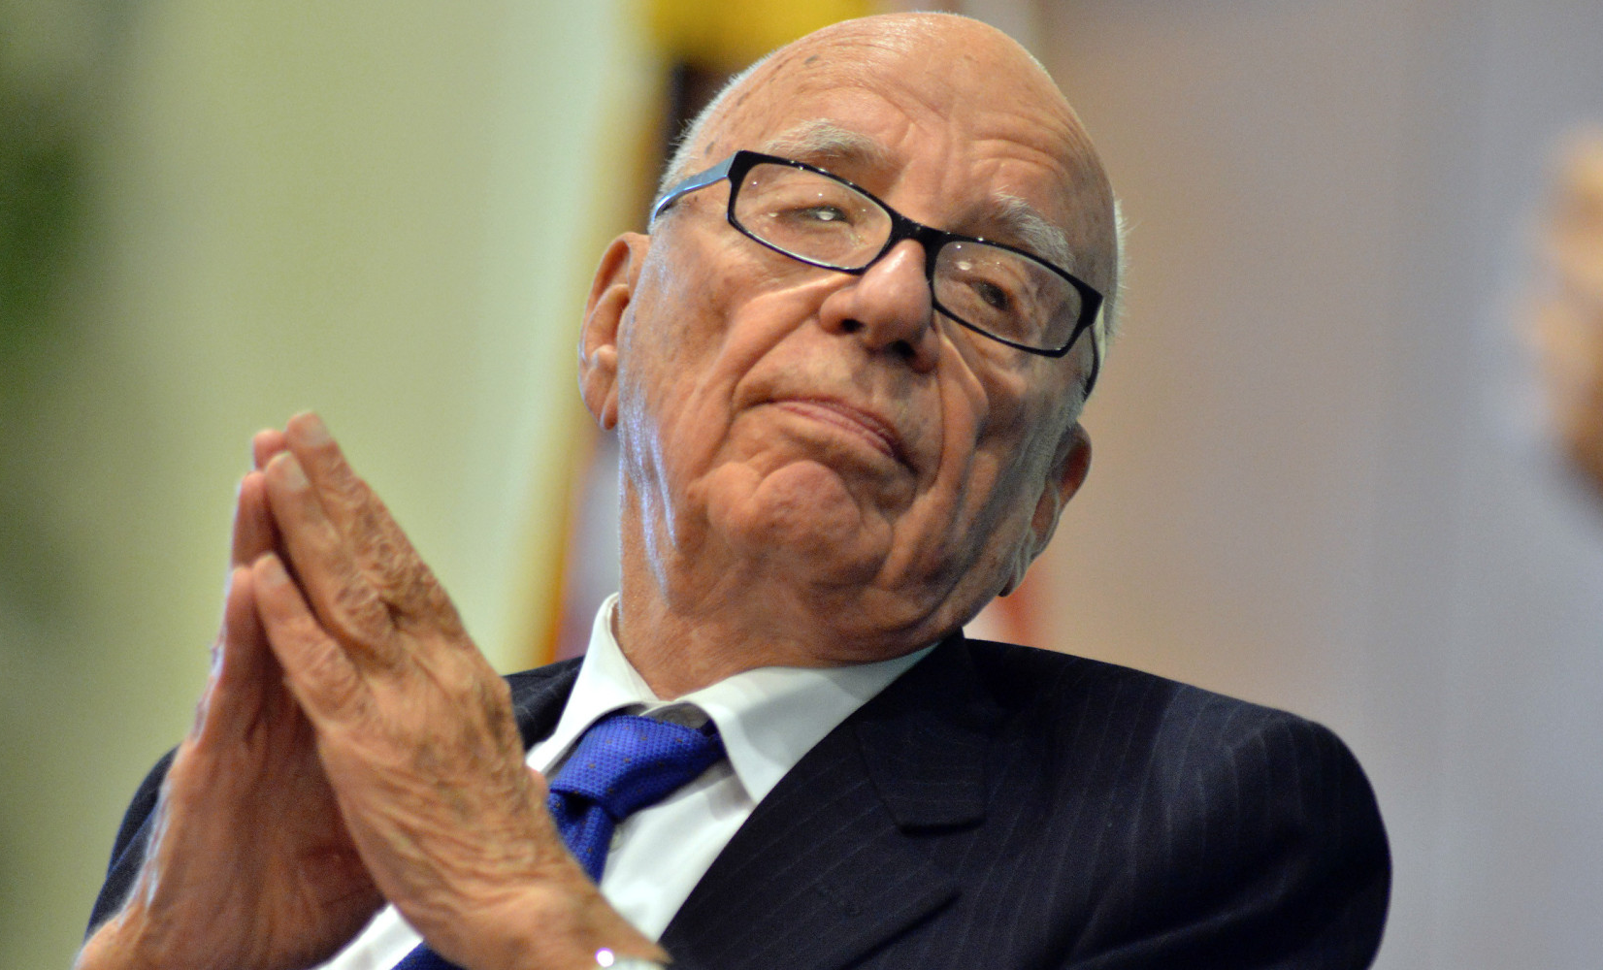
Worked for him

Slide 4
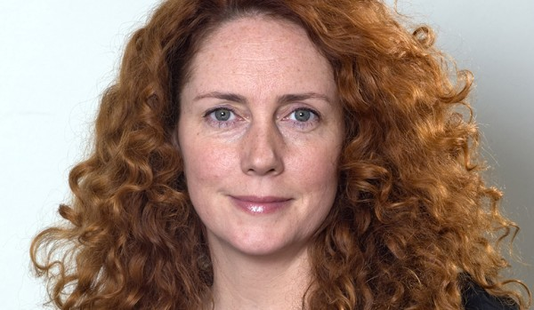
But not for her

Slide 5
I worked for them
and the BBC, New York Times, France24,WSJ, Vice, Fox News, Yahoo! News, witnesses, and the audience.

Slide 6
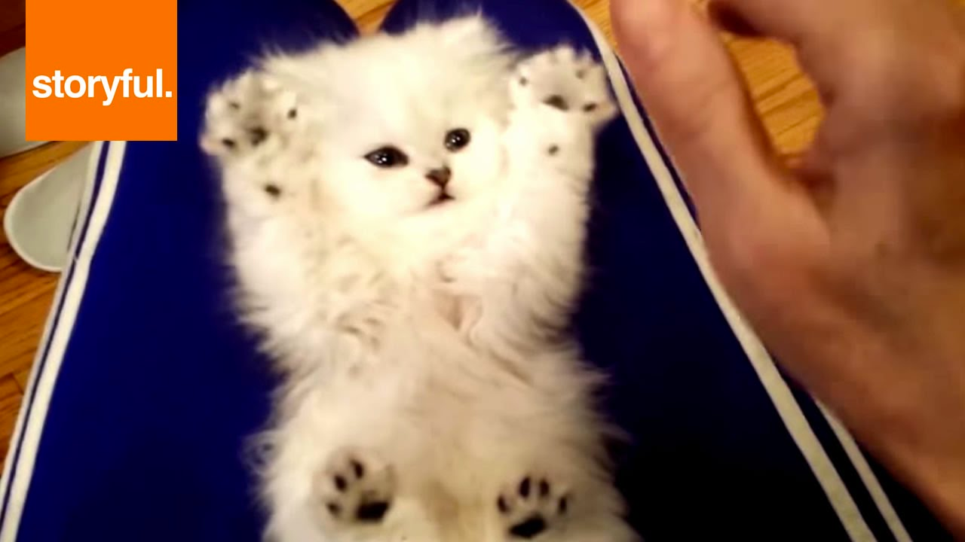
From Cats

Slide 7
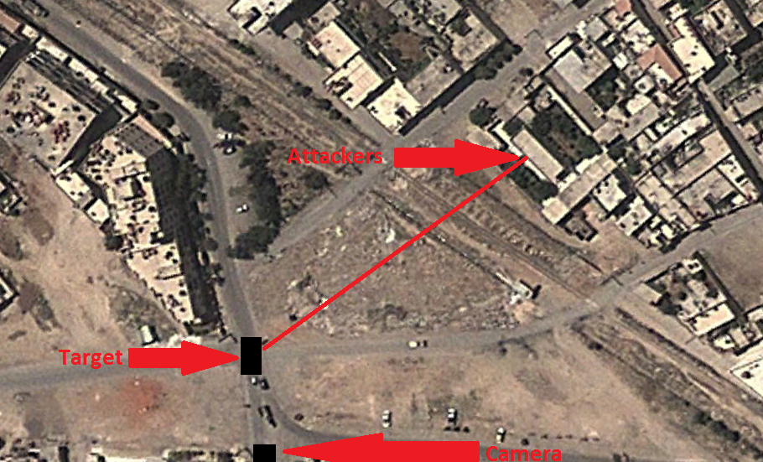
To Daraya

Slide 8

Product?
A device or system that repeatedly solves a problem at scale

Slide 9
First Opinion
Know your customers, know the problem

Slide 10

Second Opinion
Have a mission, values, and a strategy

Slide 11

Third Opinion
Work with good people who have skills, know your people

Slide 12
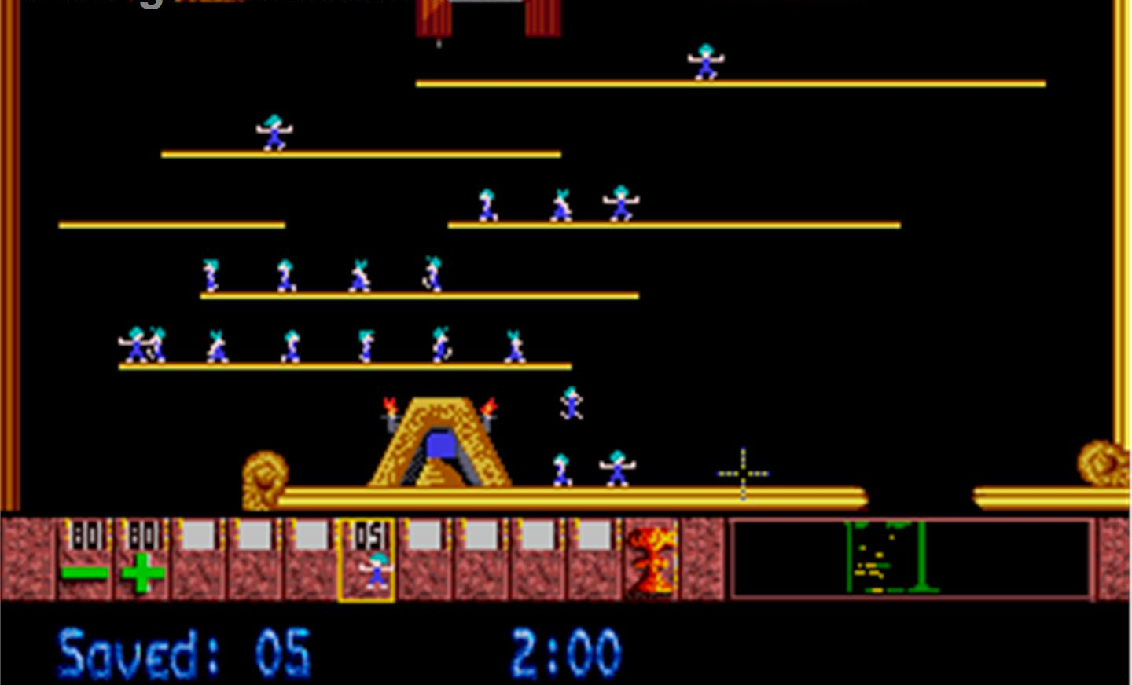
Fourth Opinion
Small teams of peers loosely coupled

Slide 13
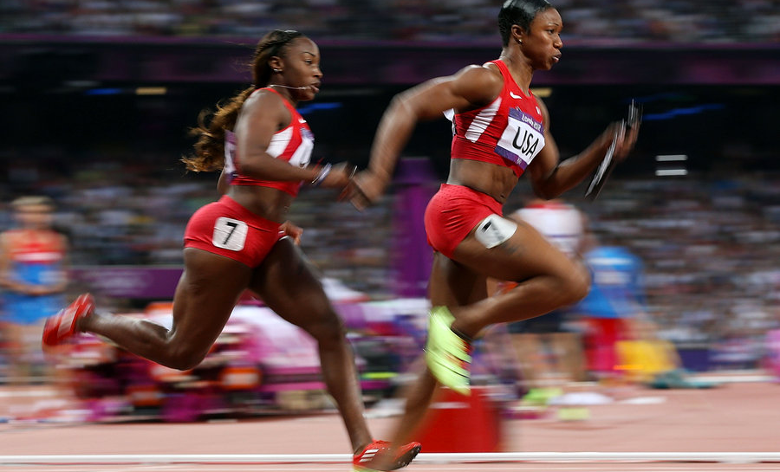
Fifth Opinion
2 week process, time and space, agile

Slide 14
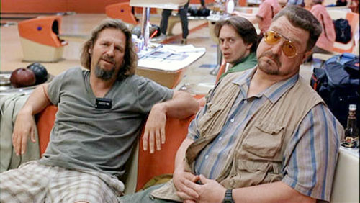
Sixth Opinion
Change your opinion; measure, test, learn and adapt.

Slide 15
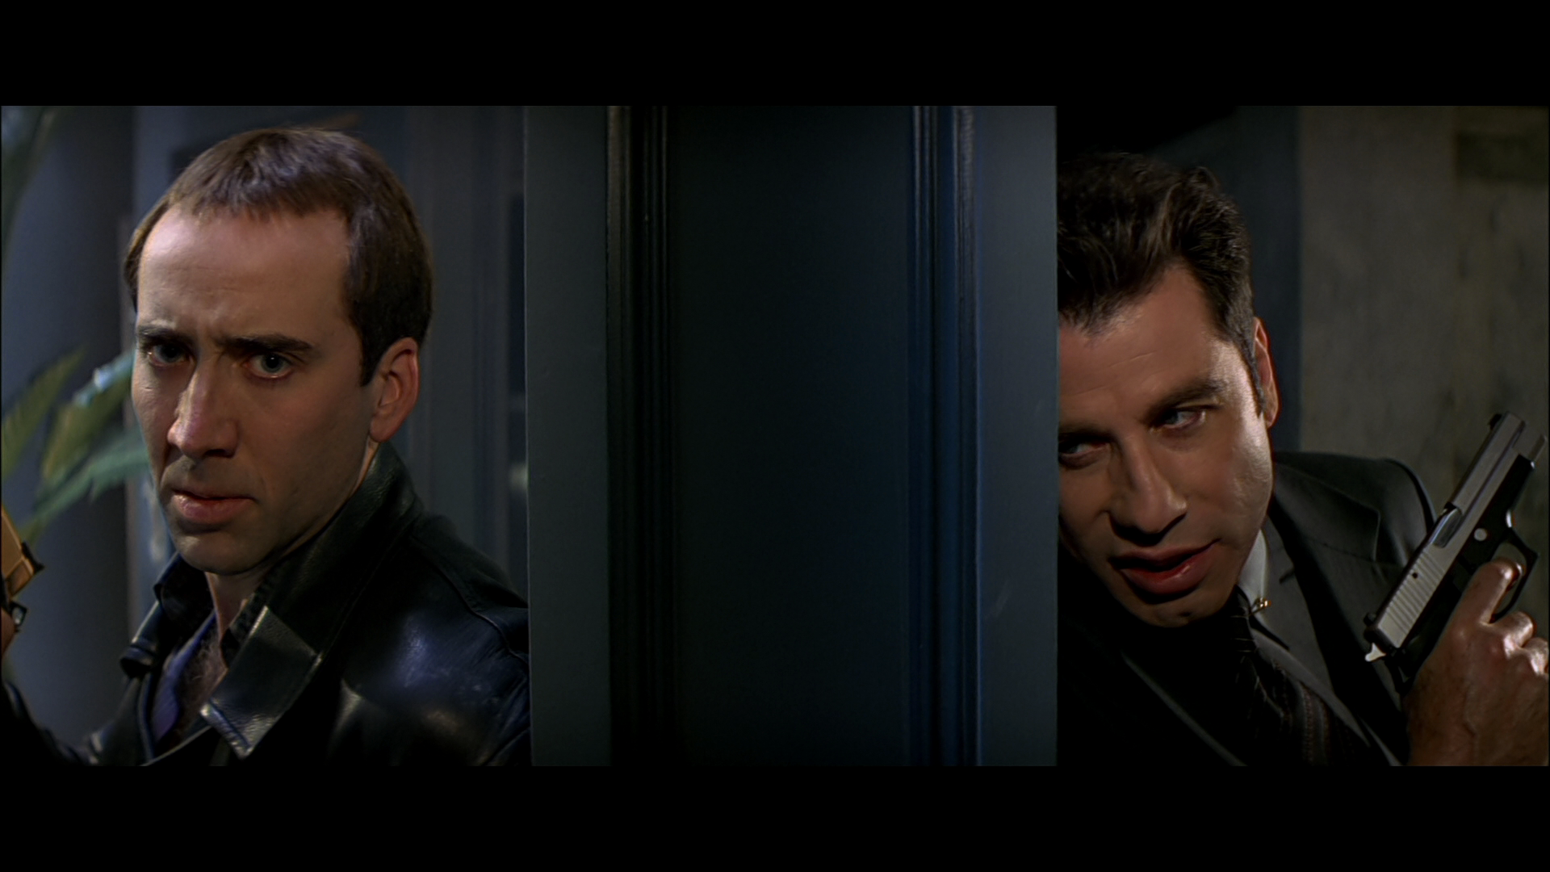
Seventh Opinion
Be resilient, work with the fringes, perfection is the enemy of good, angst is for teenagers

Slide 16
Your opinion?

